Slide 1

Recommending Your Ideal Restaurant
Cleveland, OH
Jeff Kortis
April 4, 2019

Slide 2

Introduction
We'll start in the city of Cleveland, OH. A town rich with history that went through some hard times leading up to the turn of the century. Since 2009, the city has been rejuvenated with an ample amount of new construction projects bringing new and exciting venues to old buildings once barren.
Objective: Recommend a Cleveland, OH area restaurant based on a users preferences of previously visited locations

Slide 3


Datasets
Neighborhoods of Cleveland
https://en.wikipedia.org/wiki/Category:Neighborhoods_in_Cleveland
Geographic Information on Neighborhoods
CSV file scraped from GeoHack on the aforementioned neighborhoods and uploaded to Kaggle
Cleveland Venues
Specifically restaurant venues pulled from the Foursquare API

Slide 4
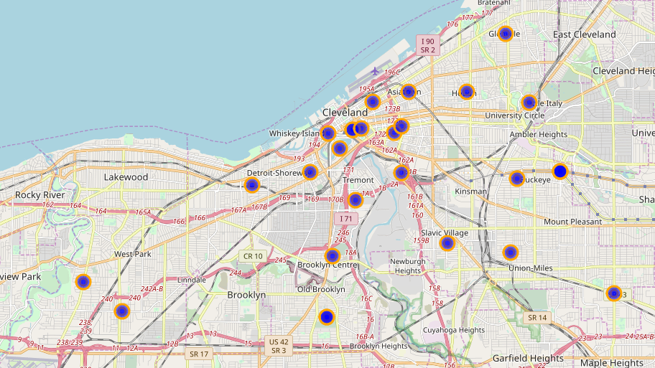
Neighborhoods of Cleveland, OH
32 total neighborhoods in the metro area
2 had no geographic information (latitude/longitude) and were dropped

Slide 5
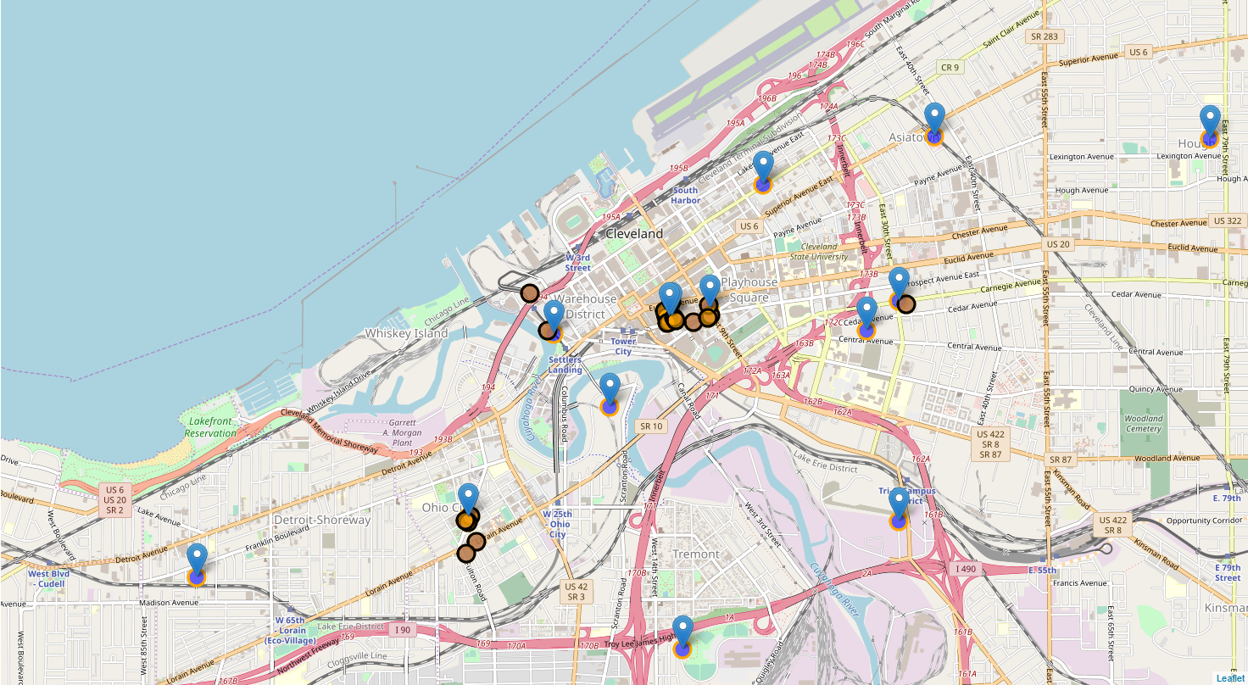
Top Neighborhoods by Restaurant Volume
East 4th Street District
Ohio City
Nine-Twelve District
Downtown Cleveland
Tremont

Slide 6
Top Restaurants by Rating
Lola Bistro – 9.3
The Greenhouse Tavern – 8.7
Mabel’s BBQ – 8.5
Butcher and the Brewer – 8.4
Saigon Restaurant & Bar – 8.3

Slide 7
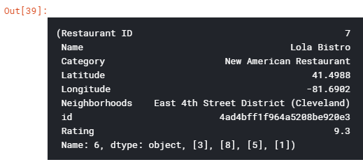
Recommended Restaurant
The top recommendation from our engine for our user was Lola Bistro in the East 4th District
This is based on the Pearson Correlation Function for a recommender system

Slide 8
Conclusions
Foursquare does not have a lot of data on Cleveland area restaurants. Other sites such as OpenTable or Grubhub may be better suited to provide ample data for evaluation

